Slide 1
Stacked Convolutional Auto-Encoders for Hierarchical Feature Extraction (CAE)
Jonathan Masci 2011 ICML

Slide 2
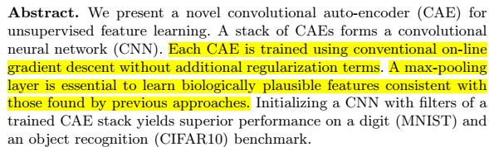
1
Scenario & Problem

Slide 3




1
Scenario & Problem

Slide 4
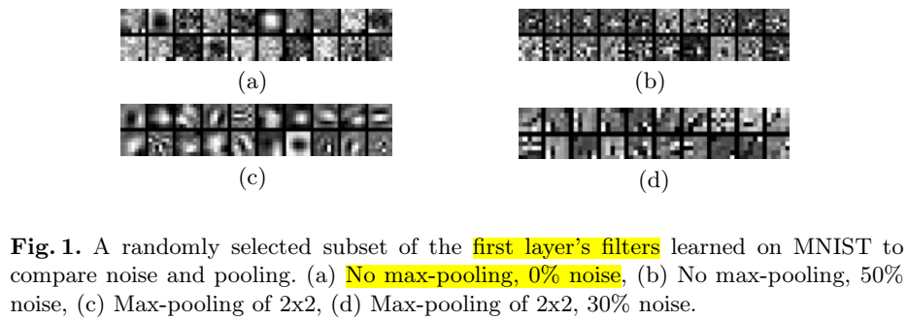
1
Experiment

Slide 5
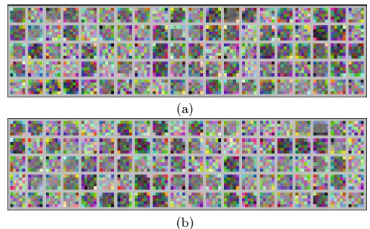
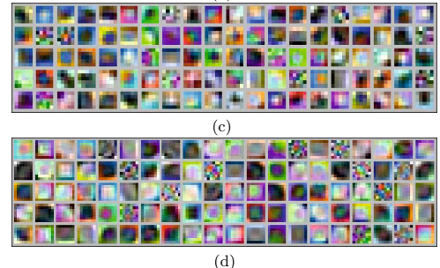

1
Experiment

Slide 6
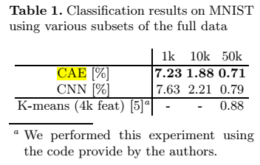
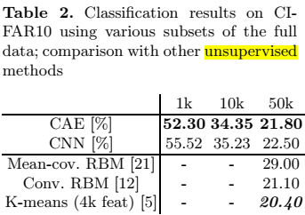
1
Experiment

Slide 7
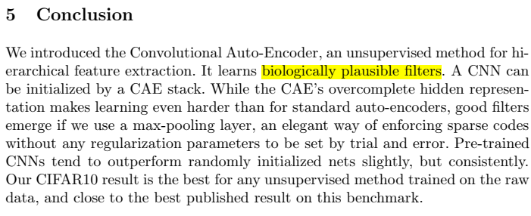
4
Conclusion

